Slide 1
Adding Custom Instructions To The RISC-V Toolchain March 16th, 2023 Garrett O’Neill

Slide 2
Contents
Chapter# Description Page#
1 Summary………………………………………………….. 3
2 Links, Resources…………………………………………. 4
3 Configuring The Virtual Machine………………………… 5
4 Downloading The RISC-V Toolchain…………………….. 6
5 Downloading Additional Packages………………………. 7
6 Designing A Custom Instruction…………………………. 8
7 Source Code Edits………………………………............. 9
7-1 Header Files………………………………………. 10
7-2 C Files …………………………………………….. 14
8 Building The Toolchain…………………………………… 18
9 Compiling A Test Program………………………………. 22

Slide 3
1) Summary
This document gives a step-by-step guide on how to:
Design a custom RISC-V instruction.
Add that instruction to the RISC-V toolchain source code.
Rebuild the RISC-V toolchain from source.
Compile and assemble source code (with your custom instruction) for a RISC-V target. For demo purposes, the target device used in this document will be the CPE 233 Multicycle OTTER.
Important Notes:
To build our modified RISC-V toolchain, we will be using an Ubuntu environment running on a virtual machine.
This guide is tailored specifically to the RV32I instruction set for bare-metal applications only. If building a toolchain that includes additional RISC-V extensions, some of the steps in this document will need to be modified. I will call out these steps, however the exact modifications that must be made will require some additional research outside of this document.

Slide 4
2) Links, Resources
Source repository for this document: https://github.com/geoneill12/Extending_RISCV
Multicycle OTTER development tools: https://github.com/geoneill12/otter-tools-p1
RISC-V toolchain: https://github.com/riscv-collab/riscv-gnu-toolchain
Ubuntu download: https://ubuntu.com/download/desktop

Slide 5
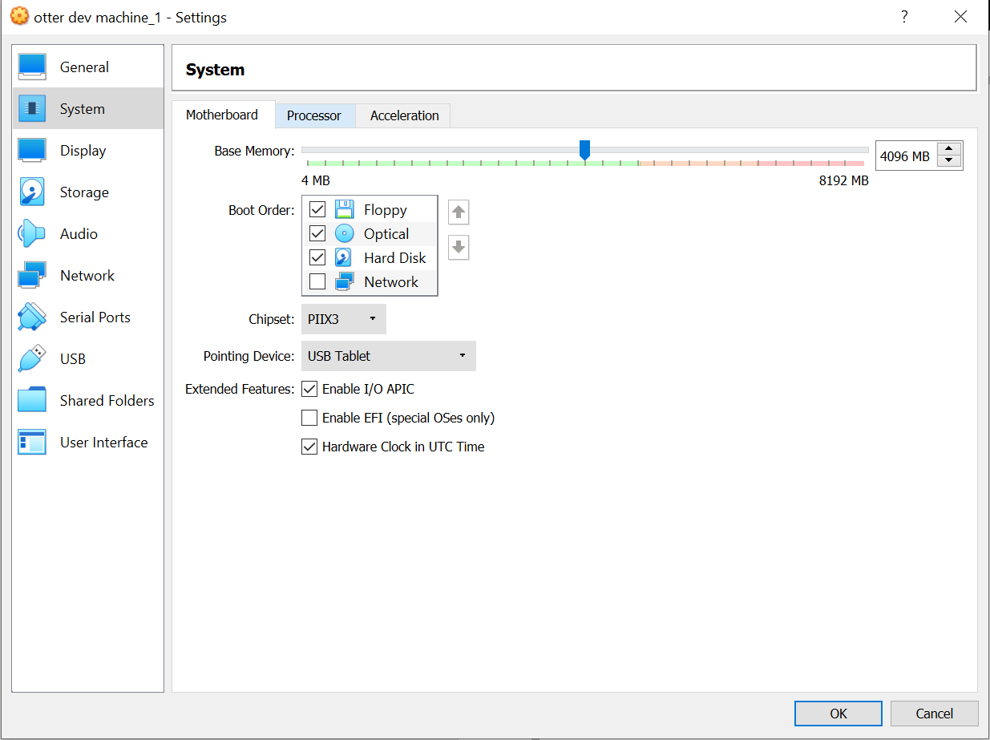
3) Configuring The Virtual Machine
Before starting your virtual machine, increase the base memory to 4096 MB. Normally I only allocate 2048 MB to a virtual machine; however, on one occasion the toolchain build failed due to memory exhaustion. For good measure I doubled the memory to 4096 MB, which fixed the problem. This may slow down the host machine slightly, but we only need to do this while the toolchain is building.
Additionally, the toolchain source files require about 6.65 GB of disk space. Make sure your virtual machine has enough disk space on your host machine to accommodate this.
Note: If already running Ubuntu as your primary operating system, skip to chapter 4.

Slide 6
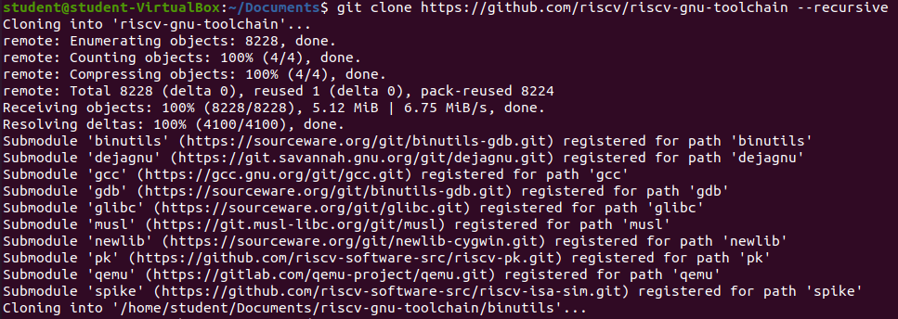
4) Downloading The RISC-V Toolchain
Clone the RISC-V toolchain into the directory of your choice:
git clone https://github.com/riscv/riscv-gnu-toolchain --recursive
The repository uses submodules. If --recursive is not included, most of the source files will not be fetched, since they reside in these submodules.

Slide 7
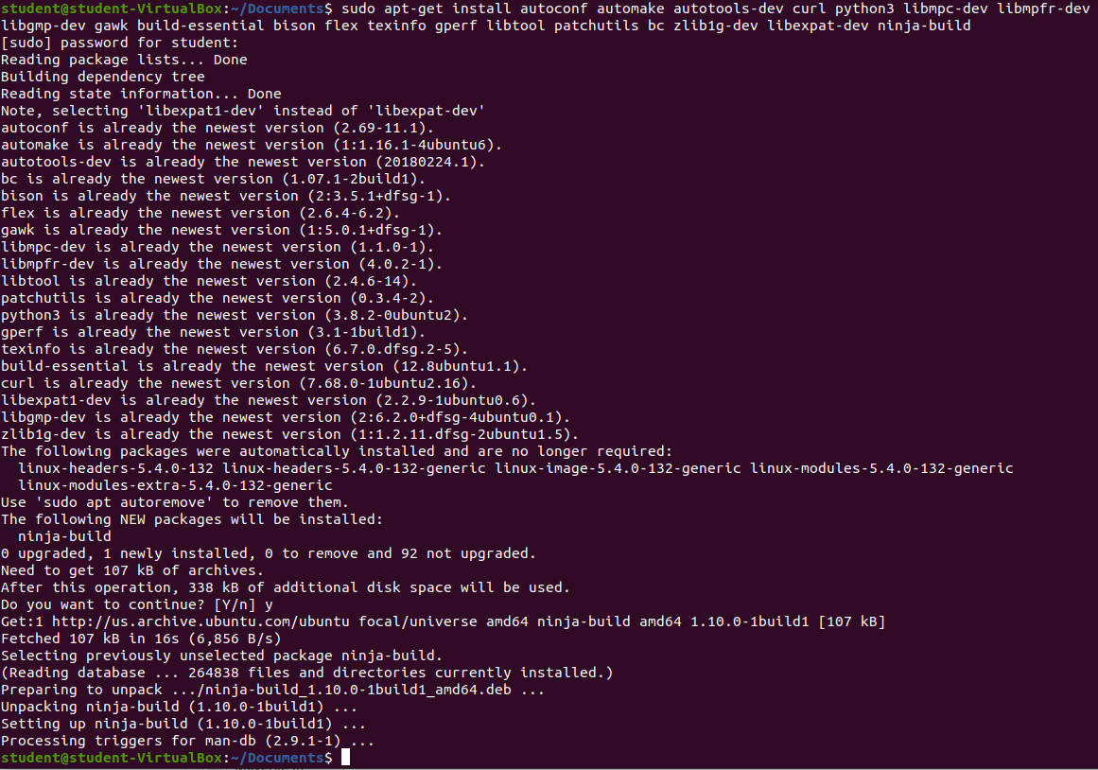
5) Downloading Additional Packages
Run the following command to ensure that all packages needed to build the toolchain are installed:
sudo apt-get install autoconf automake autotools-dev curl python3 libmpc-dev libmpfr-dev libgmp-dev gawk build-essential bison flex texinfo gperf libtool patchutils bc zlib1g-dev libexpat-dev ninja-build

Slide 8
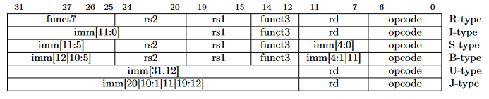
6) Designing A Custom Instruction
To illustrate how to design a custom instruction, I will use a custom instruction called otter, with the following semantics:
otter rd, rs1, rs2
The otter instruction is a 32-bit, R-type instruction. Below are the different instruction types for 32-bit RISC-V instructions:
An R-type instruction has the following:
A 7-bit opcode field (bits 6-0).
A 10-bit, non-contiguous function field (bits 31-25 and 14-12).
3 operands: destination register, source register 1, source register 2 (bits 11-7, 19-15, and 24-20 respectively).
The opcode and function fields are always constant, so we need to choose values for these fields. For the otter instruction, I have arbitrarily chosen the following values for the opcode and function fields:
opcode = 7’b0100111
function = 10’b0000000110
The opcode I picked is unique and does not match the opcode of any of the RV32I base instructions.
Note: The official RISC-V specification contains guidelines on ISA extensions, including naming conventions, opcode format, etc.

Slide 9
7) Source Code Edits
To implement our custom instruction into the RISC-V toolchain, we need to modify the following 2 files:
riscv-gnu-toochain/binutils/include/opcode/riscv-opc.h
riscv-gnu-toochain/binutils/opcodes/riscv-opc.c
Additionally, the same modifications can be made to the following 2 files so that we can use our custom instruction with gdb:
riscv-gnu-toochain/gdb/include/opcode/riscv-opc.h
riscv-gnu-toochain/gdb/opcodes/riscv-opc.c

Slide 10
7-1) Source Code Edits – Header Files
First, we need to create 2 macros based on the opcode and function values we picked for our instruction in chapter 6. For our otter instruction, these macros will be called “MATCH_OTTER” and “MASK_OTTER”.
MATCH_OTTER
Write out the complete machine code value of the new instruction, filling in the opcode and function bits using the values chosen in chapter 6. For the operands, replace them with X’s.
Replace all X’s with 1’s.
The resulting hexadecimal value is the “MATCH_OTTER” macro.
MASK_OTTER
Write out the complete machine code value of the new instruction, this time placing all 1’s in the opcode and function fields, and 0’s in all the operand fields.
The resulting hexadecimal value is the “MASK_OTTER” macro.
The resulting macros for our otter instruction are:
#define MATCH_OTTER 0x6027
#define MASK_OTTER 0xfe00707f

Slide 11
7-1) Source Code Edits – Header Files
Some Notes On The Instruction Macros
The toolchain seems to use the “MATCH_” macro to determine the value of the instruction’s constant fields (opcode and function), while using the “MASK_” macro to differentiate the location of the operand fields from the location of the constant fields.
If creating an instruction with a period in it (i.e. otter.r, otter.h, etc.) replace the period with an underscore in the macro name.
ex) “otter.r” would have macros “MATCH_OTTER_R” and “MASK_OTTER_R”.

Slide 12
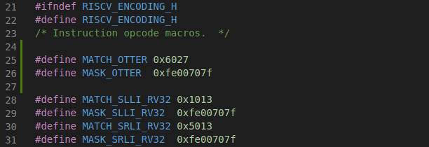
7-1) Source Code Edits – Header Files
Add the “MATCH_OTTER” and “MASK_OTTER” macros to the following header files:
riscv-gnu-toochain/binutils/include/opcode/riscv-opc.h
riscv-gnu-toochain/gdb/include/opcode/riscv-opc.h

Slide 13
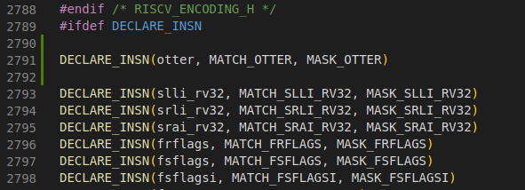
7-1) Source Code Edits – Header Files
In the same header files from the previous page, add the following line:
DECLARE_INSN(otter, MATCH_OTTER, MASK_OTTER)
This declaration requires the instruction name, and our “MATCH_” and “MASK_” macros.
Note: If creating an instruction with a period in it (i.e. otter.r, otter.h, etc.) replace the period with an underscore in the declaration above.
ex) “otter.r” would be DECLARE_INSN(otter_r, MATCH_OTTER_R, MASK_OTTER_R)

Slide 14
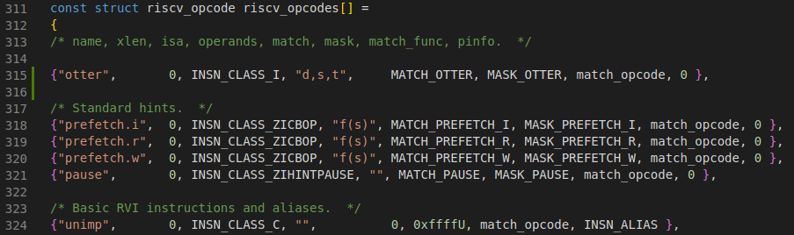
7-2) Source Code Edits – C Files
There is an array of structs called “riscv_opcodes” in each of the following C files:
riscv-gnu-toochain/binutils/opcodes/riscv-opc.c
riscv-gnu-toochain/gdb/opcodes/riscv-opc.c
Every RISC-V instruction has an entry. We need to add an entry for out otter instruction.

Slide 15
7-2) Source Code Edits – C Files
The template for each struct entry is:
{name, xlen, isa, operands, match, mask, match_func, pinfo}
name: Name of our instruction.
xlen: Bit width of an integer register, either 32 or 64.
isa: The specific ISA our instruction is targeting.
operands: Symbols that specify the exact type of operands an instruction uses.
match: The “MATCH_” macro defined in “riscv-opc.h”.
mask: The “MASK_” macro defined in “riscv-opc.h”.
match_func: Not certain what this field does, but it may have to do with how the toolchain checks that an instruction was formatted correctly.
pinfo: Not certain what this field does.

Slide 16
7-2) Source Code Edits – C Files
Our otter instruction will have the following entry
{“otter”, 0, INSN_CLASS_I, “d,s,t”, MATCH_OTTER, MASK_OTTER, match_opcode, 0}
“otter”: Name of our instruction.
0: Our instruction is targeting a 32-bit architecture, however specifying 0 appears to allow an instruction to be used for both 32-bit and 64-bit architectures.
INSN_CLASS_I: Entry for the RV32I ISA.
“d,s,t” : Symbols for our operands. These are explained more thoroughly on the next page.
MATCH_OTTER: The “MATCH_” macro defined in “riscv-opc.h”.
MASK_OTTER: The “MASK_” macro defined in “riscv-opc.h”.
match_opcode: Since I’m not certain what this field does, I reused the same entry used by other RV32I instructions.
0: Since I’m not certain what this field does, I reused the same entry used by other RV32I instructions.

Slide 17
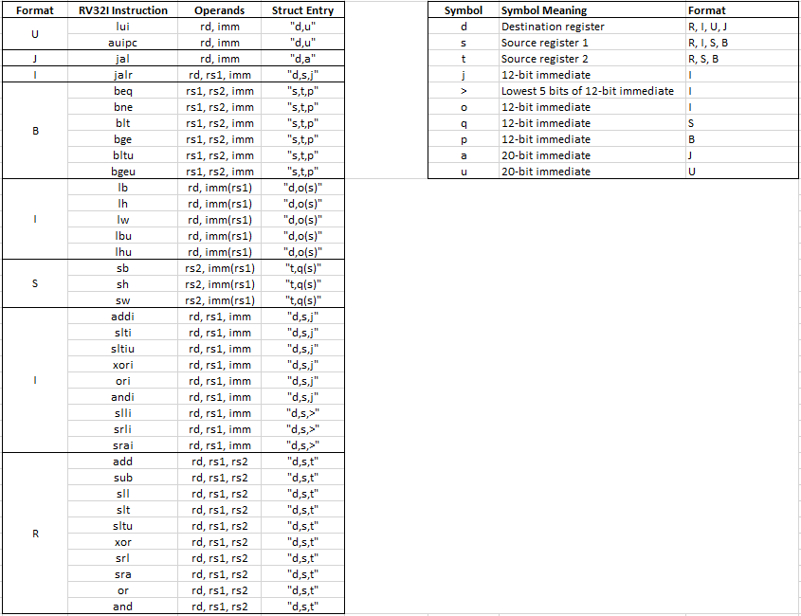
7-2) Source Code Edits – C Files
The above table shows the struct entry for the “operands” field of each of the RV32I base instructions (obtained from the “riscv-opc.c” file). By comparing the operand symbols with the instruction’s actual operands and instruction format, we can infer their meaning.
Note: The file that parses through these symbols seems to be located here:
riscv-gnu-toochain/binutils/gas/config/tc-riscv.c

Slide 18
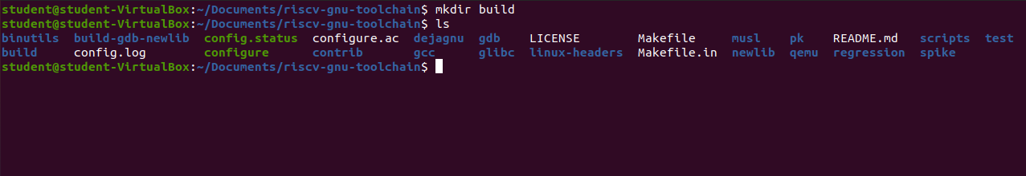
8) Building The Toolchain
Before building the toolchain, we need to create a destination directory where the output files will be stored. For my build, I chose to create the following destination:
riscv-gnu-toolchain/build

Slide 19
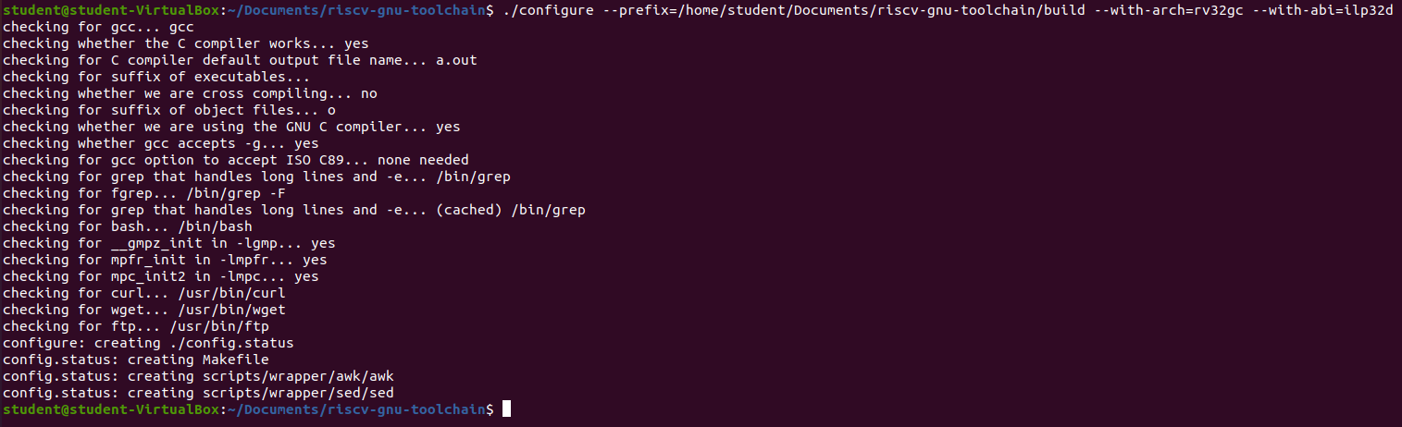
8) Building The Toolchain
Navigate to the riscv-gnu-toolchain directory and run the following command:
./configure --prefix=<build_directory> --with-arch=rv32i --with-abi=ilp32
Replace <build_directory> with the absolute path to the build directory you chose.
The --with-arch and --with-abi flags have default values that the toolchain will build to if not specified. For this build, we only want the toolchain to build for the RV32I ISA, so we pass the flags pictured above. For different architectures, these flags will need to be modified.
The RISC-V Toolchain Repository explains these flags further.

Slide 20
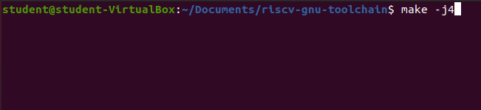
8) Building The Toolchain
Run the make command to start building the toolchain:
make –j<# of threads>
If successful, the toolchain build will take 30-60 minutes depending on how many threads you specified.
Note: Some online guides say to run make linux. If building the toolchain for only the RV32I ISA, this will cause the build to fail. This is likely due to the toolchain trying to build files for linux applications that explicitly require additional ISAs beyond just RV32I.

Slide 21
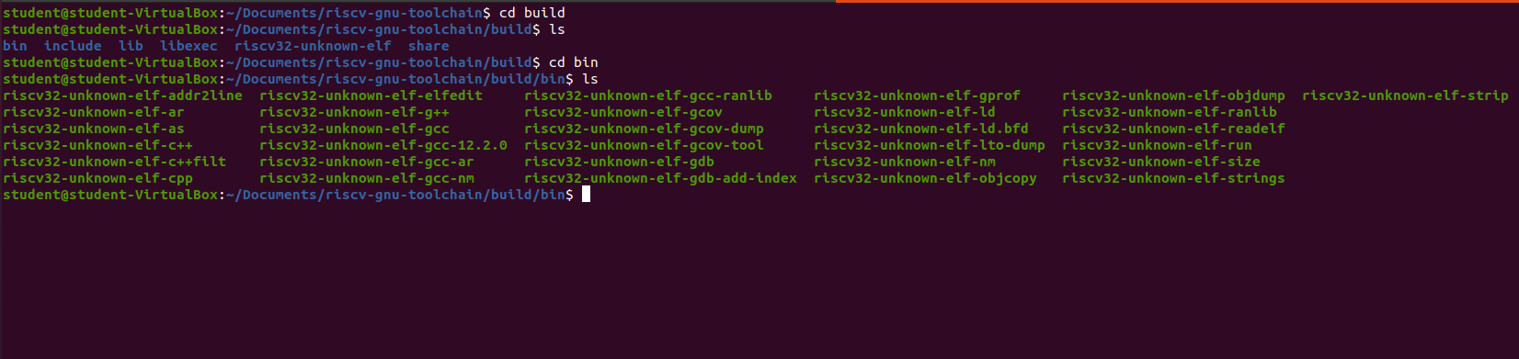
8) Building The Toolchain
After the toolchain is built successfully, we can navigate into the build directory and see what was built. The bin directory contains the executable files we need.
Note: Now that the toolchain is built, remember to decrease the virtual machine’s base memory back to its original value.

Slide 22
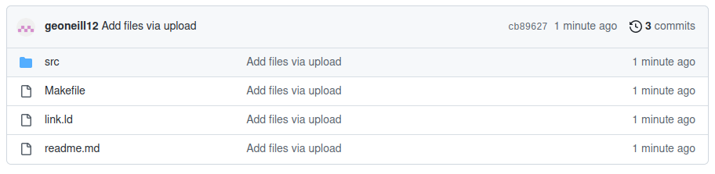
9) Compiling A Test Program
Fetch the files from the following repository:
otter-tools-p1
The repository contains a makefile, linkerscript, and a test program for the RISC-V target device I am using to demo the new instruction.

Slide 23
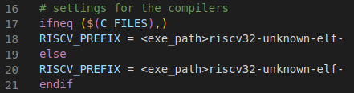
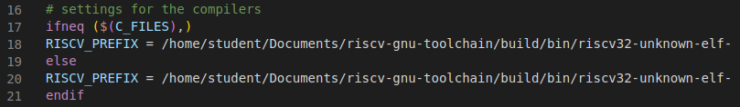
9) Compiling A Test Program
If you happen to have multiple versions of the RISC-V toolchain installed on your system, you’ll need to specify which version to use when trying to compile programs with your custom instruction. An easy way to do this is by specifying the absolute path to the modified toolchain in a makefile.
Open the makefile. On lines 18 and 20, replace <exe_path> with the absolute path to the toolchain executable that supports your custom instruction. For this build, the absolute path is:
/home/student/Documents/riscv-gnu-toolchain/build/bin/
Thus, the RISCV_PREFIX values become:

Slide 24
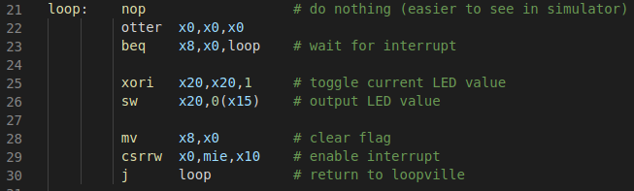
9) Compiling A Test Program
Open “main.s” in the src directory and add the custom instruction somewhere and specify the operands. For this demo, placement doesn’t matter.
Note: Depending on what text editor you use, syntax highlighting probably won’t highlight your new instruction since it wouldn’t recognize it as an instruction.

Slide 25
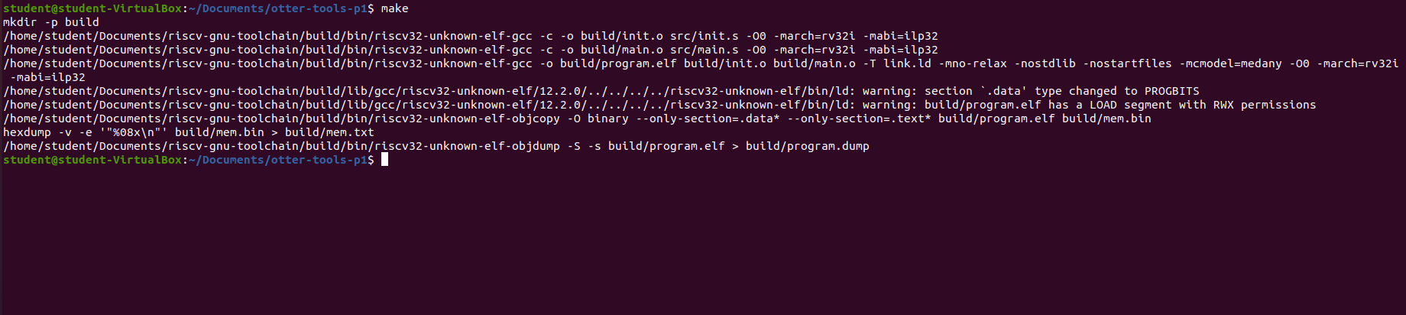
9) Compiling A Test Program
Navigate to the otter-tools-p1 directory and run make.

Slide 26
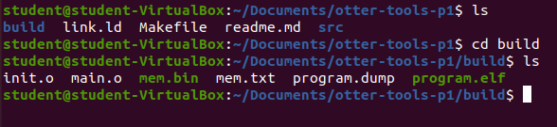
9) Compiling A Test Program
A build directory will be created with several output files.

Slide 27
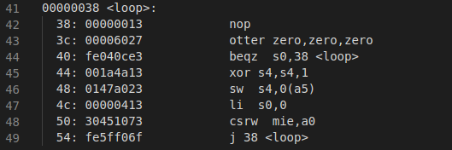
9) Compiling A Test Program
Opening the “program.dump” file shows the disassembly of our compiled program with our custom instruction!

